Slide 1
Boeing India University Relations
Industry Ready Engineer - Critical Design Reviews (CDR)
Underwing Payload Hardpoint for MALE UAV
August 2024

Slide 2
Project Stakeholders
Primary Stakeholders | Secondary Stakeholders | Internal Stakeholders
Customers Indian Airforce Indian Navy Indian Army Other armed forces, local and global. | Regulatory Bodies DGCA Ministry of Defence Suppliers Machining services Electronic wiring/connectors Sensors | Boeing India Private Limited R.V. College of Engineering

Slide 3
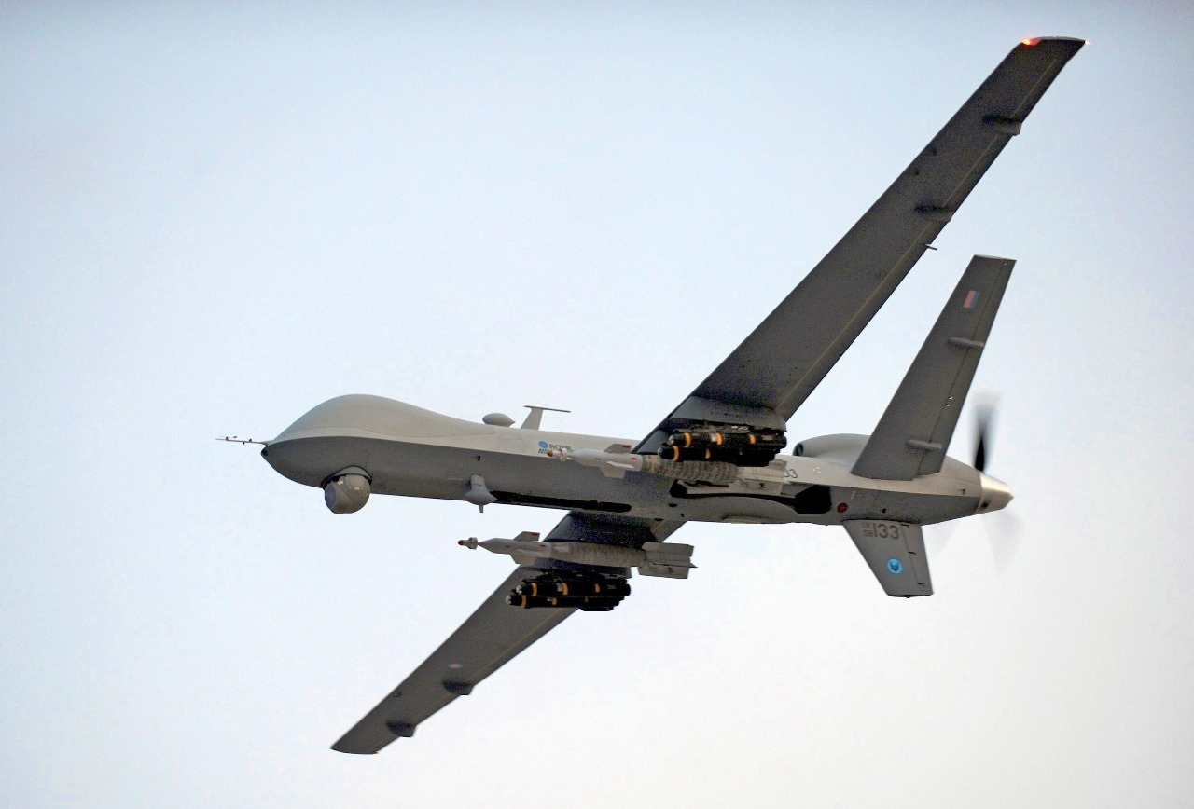
Project Overview
*Source: POA(Phot) Tam McDonald/MOD, UK

Slide 4
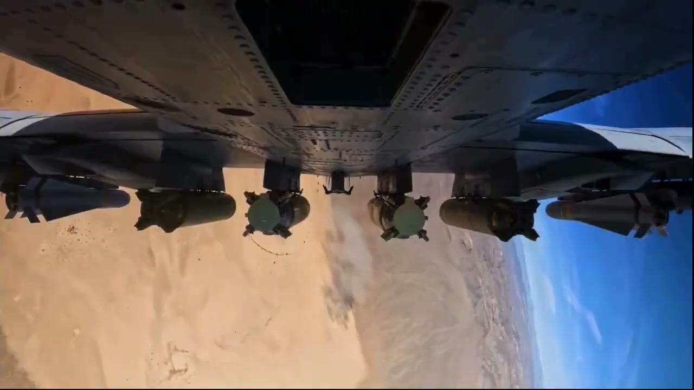
Project Objective
Payload Jettison
*Source: 422nd Test & Evaluation Squadron Social Media

Slide 5
Project Objectives
Create a robust, modular, and aerodynamically optimized hardpoint to enhance the MALE UAV’s capability to carry and deploy diverse payloads.
Establish a unified understanding of the project’s objectives, scope, and architecture among stakeholders.
Guide the development process with specific system requirements and safety assessments, adhering to SAE ARP4745A guidelines.

Slide 6
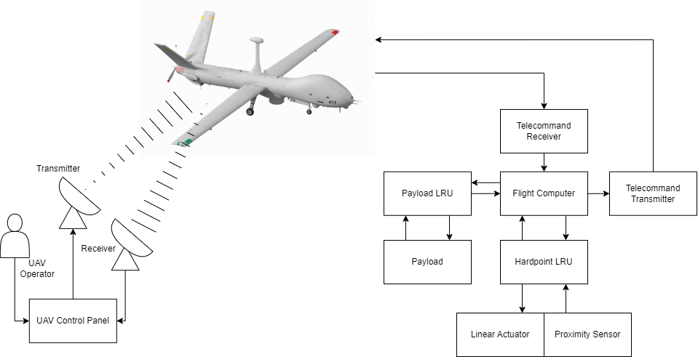
UAV Operator Interface Architecture

Slide 7
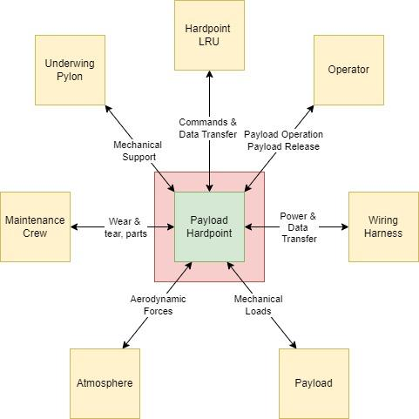
Context Diagram

Slide 8
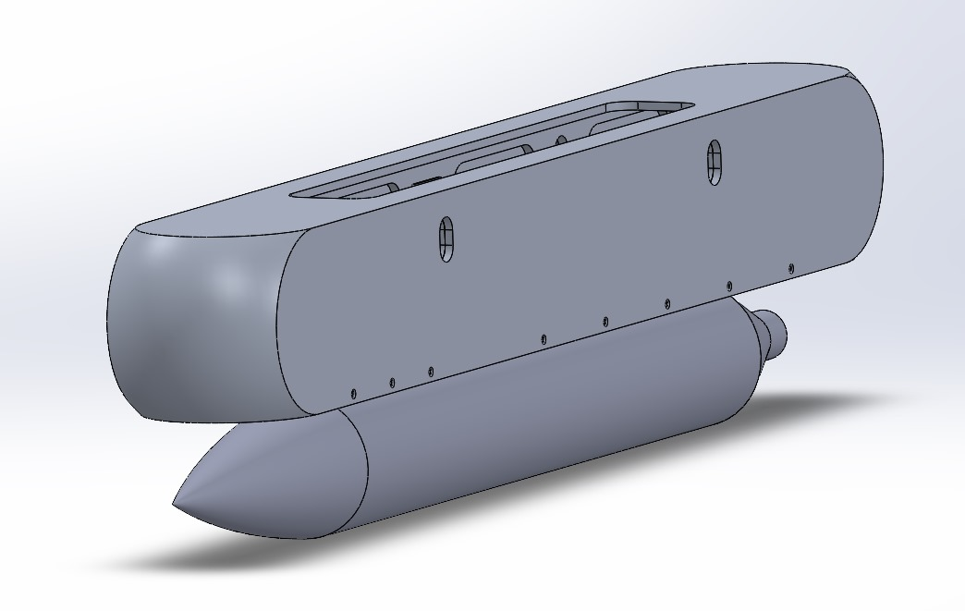
Project Objective
Hardpoint fitted with payload

Slide 9
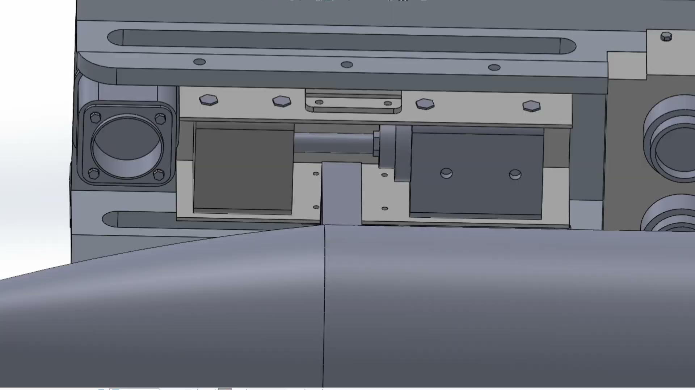
Project Objective

Slide 10
Requirements

Slide 11
Establishment & Development of Requirements
Requirements, especially Tier-1, had to be deduced from desirable functions/characteristics as seen by operators.
Put ourselves in the shoes of the end customer, with the context of how MALE UAVs are being used in theatres all over the world.
Challenges faced: Lack of structured, well-defined requirements; lack of open source/declassified information due to nature of the product.
Tools used to organize requirements: Compliance Matrix, FHA, FTA, FMEA

Slide 12
Example of Traceability & Rationale from Tier-1 to Tier-2 to Tier-3 Requirements
Requirement ID | Requirement | Requirement Type | Requirement Validity | Traceability/ Rationale | Product Verification Method | Product Verification Owner | Product Verification Evidence | Verification Comments | Compliance
T1-R-1 | The UAV, with this hardpoint, should be able to support the carry & operation of a wide range of payloads found on MALE UAVs without significantly affecting the performance characteristic of the UAV. | Customer | Valid | - | Analysis, Test | Requirements Engineer | - | - | Intend to comply
T2-R-1 | Operable in the flight envelope of up to 10,000m altitude, +3g -3g limit load (in pull up & pull down maneuvers in the longitudinal axis), & forward speeds of 300 km/h | Operational | Valid | Expected flight envelope of typical MALE UAV | Analysis, Test | Design Engineer | Tests & Hand Calculations performed, refer analysis document | - | Intend to comply
T2-R-5 | Maximum Payload Weight shall be 100kg | Performance | Valid | Based on the currently used missiles AIM-9 Sidewinder - 85kg IRIS-T- 87.4kg | Analysis, Test | Design Engineer | Load test reports | Validated up to 100 kgs of payload weight | Intend to comply
T2-R-8 | The hardpoint mechanism shall endure emergency loads such as gusts, landings, maneuvers (+2.5g to -1.0g) |  | Valid | FAR Part 25 | Analysis, Test | Design Engineer | - | - | Intend to comply
T3-R-10 | Rail mount that interfaces the latches to the main body of the hardpoint are to sustain a UDL of 15 kN/m | Performance | Valid | T2-R-1, T2-R-5, T2-R-8, + load of structural elements | Analysis, Test | Design Engineer, Analysis Engineer | Structural load test results, finite element analysis | Tested for ultimate load conditions | Intend to comply

Slide 13
Design Review

Slide 14
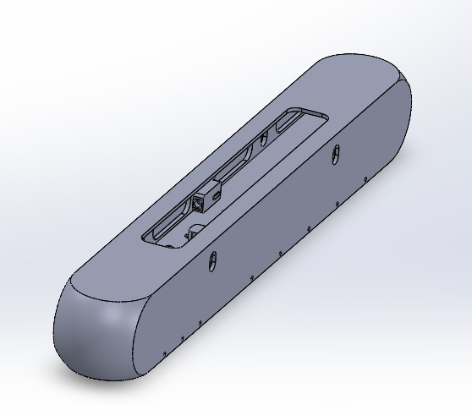
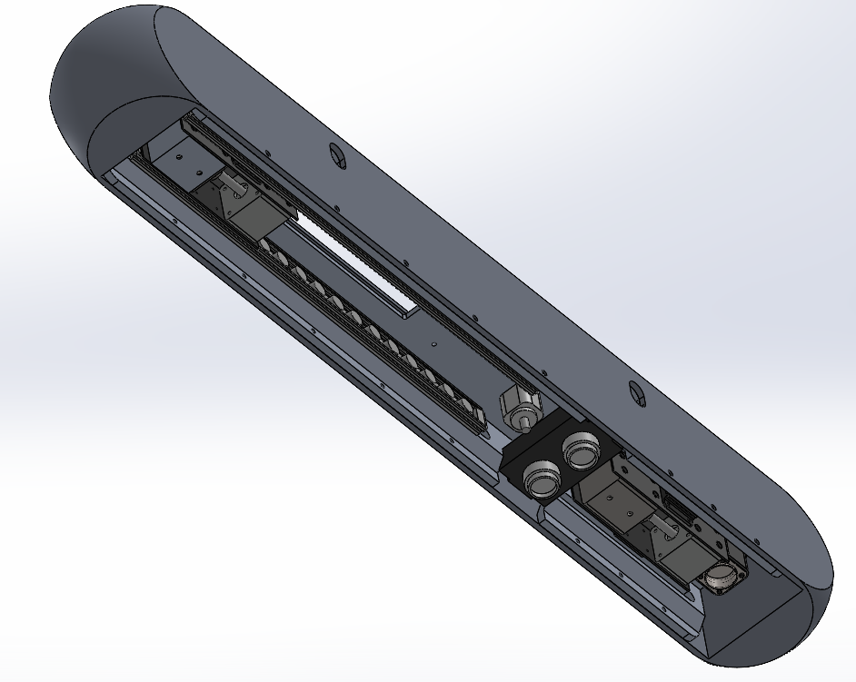
Design Overview
Fig. Isometric view of the hardpoint
Fig. Bottom view of the hardpoint

Slide 15
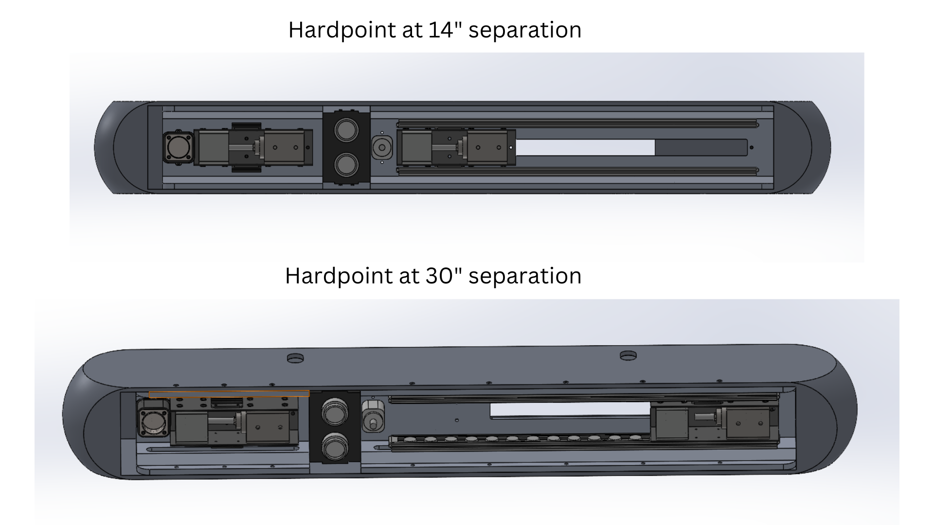
Design Overview - USP

Slide 16
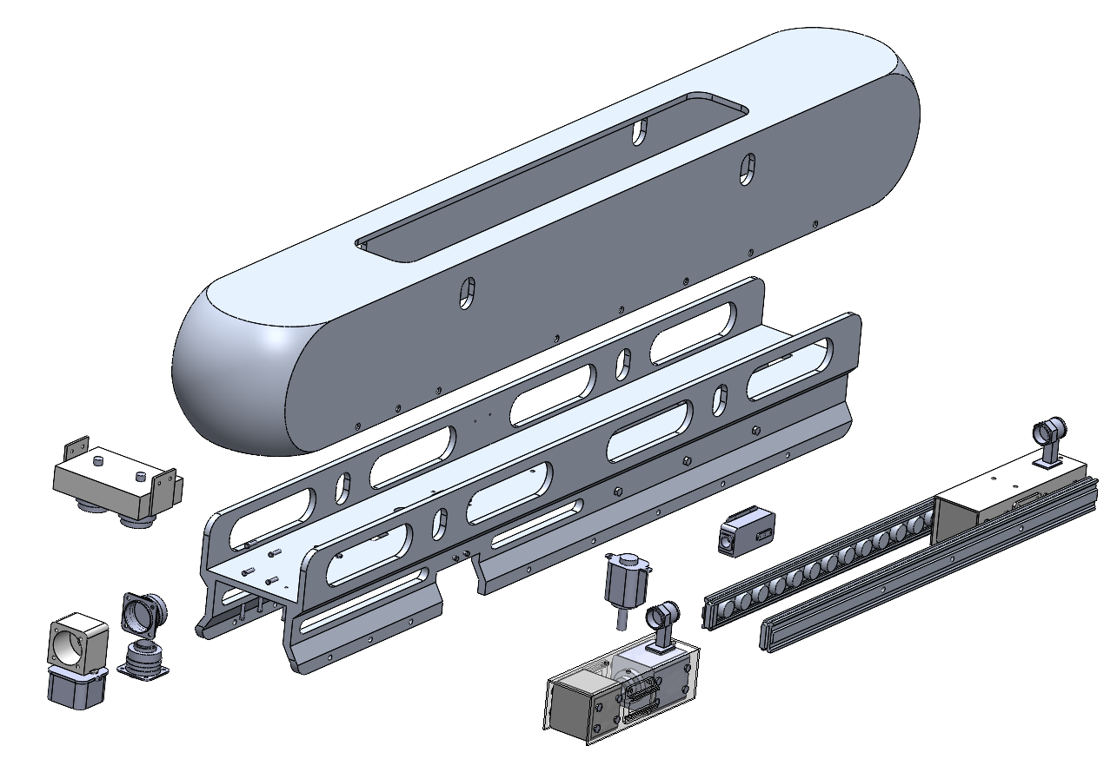
Design Overview
Exploded View of Assembly
S. No | Component
1 | Aerodynamic Fairing
2 | Main Structural Member
3 | Latch Assembly
4 | Rail Guides
5 | Negative Displacement Plunger
6 | Proximity Sensor Module
7 | 8D8 Electrical Connectors
1
2
6
4
5
7
3

Slide 17
Analysis

Slide 18
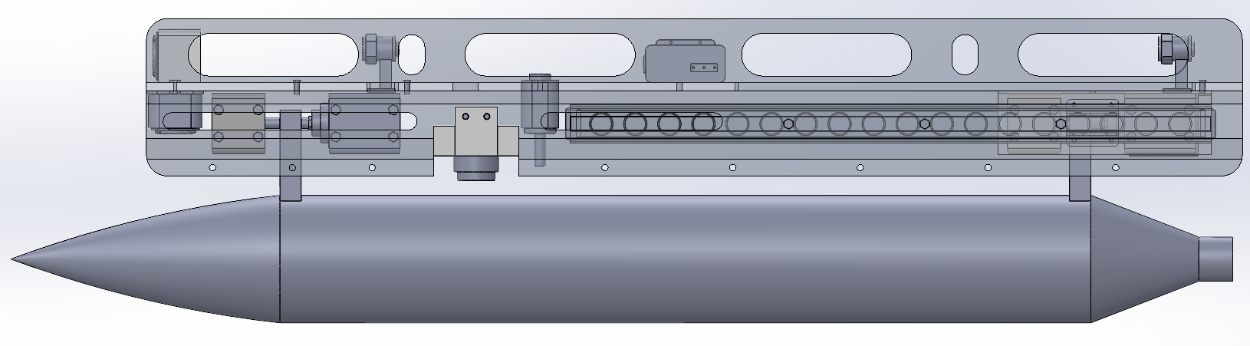
Stress Analysis
Legend
Primary Acting Load Latch Arm Load Rail Guide Bolt Reaction Force Bolt Axial Load

Slide 19
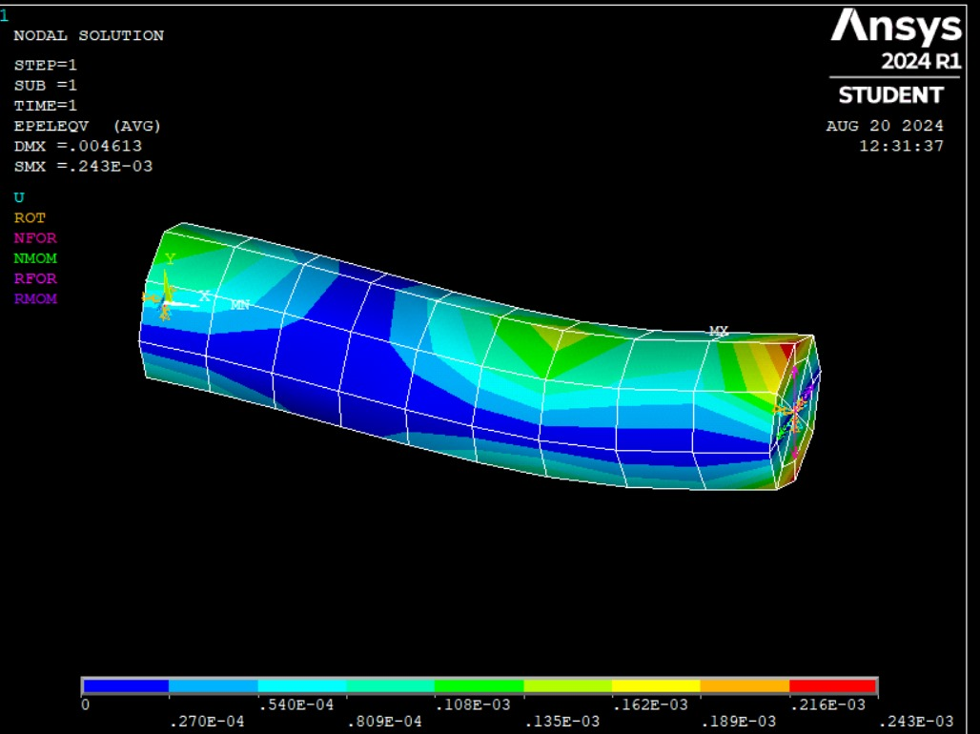
Analysis Methods & Tools
Analysis was primarily conducted via hand calculations, FEA was utilised through ANSYS APDL.
Analysis Parameters
Latch Arm Deformation
Loads under Acceleration
Fastener Operating Loads and Capacity
Drag Estimation
Analysis Outcomes
Design Verification
Failure Prediction
Efficiency Estimation
Fig: FEA analysis of Latch Arm

Slide 20
Verification & Qualification

Slide 21
Verification
Verification is process of evaluation of whether or not a product, service, or system complies with requirements
Plan verification based on design and requirements.
Execute verification methods and collect verification evidences.
Review anomalies and compile a verification summary.
Requirement ID | Requirement
T2-R-1 | Operable in the flight envelope of up to 10,000m altitude, +3g -3g, and forward speeds of 300 km/h
T2-R-2 | Actuator selected shall be robust & reliable to the highest degree possible, ensuring that the payload is not released under non-ideal conditions
T2-R-3 | A provision to detect the jettison/launch of the payload upon actuation should exist
T2-R-4 | Implement plungers that will give negative displacement of payload upon ejection/jettison of the payload, clearing it from the UAV body
Verification method
Analysis, Test
Test, analysis
Test, Inspection
Test, Inspection
Product Verification Evidence | Verification Comments
Tests & Hand Calculations performed, refer analysis document | Test results validated under various operational conditions, meeting the altitude and speed criteria
component reliability analysis, actuator stress testing | Tested under operational conditions
Integration test results, Inspection report | Detection system validated with dummy payload
Clearing mechanism tested for multiple payload configurations | Clearing mechanism verified for different payload sizes, successful tests for complete detachment

Slide 22
Qualification
Based on the FMEA, FHA & FTA the components with high risk and severity has to go through qualification test to ensure the components integrated to the UAV are airworthy.
For a military application products it is necessary to adhere to the military standards such as:
MIL-STD-810H
MIL-STD-810G
Indian Military Technical Airworthiness Requirements(IMTAR)
Procedure followed for Qualification:
List of test plans and schedule
Detailed test equipments required and procedure to be followed
Collection of test data, deviations and approvals
Documentation of the qualification tests

Slide 23
Thank You

